Slide 1
Unit 2 - Lecture 8
Heuristic search
Heuristic function

Slide 2
Introduction
In the search algorithms described in first phase, the only role that the goal node plays is in testing whether the candidate presented by the search algorithm is a goal or not.
Otherwise, the search algorithms are quite unaware of the goal node.
They always go about exploring the state space in the same order, irrespective of the goal to be achieved.
They are, therefore, called blind or uninformed.
The Depth First Search dives into the search space, backtracking only if it reaches a dead end.
If the search space were infinite, it might just keep going along an endless path.

Slide 3
The Breadth First Search, on the other hand, ventures out cautiously, going further away, only if it has finished inspecting the nodes the same distance away from the start position.
Consequently, it always finds the shortest solution, though its space requirements grow exponentially.
DFID is basically a sequence of 'depth first searches' masquerading as a breadth first search.
The search algorithms described so far maintain a list, called OPEN, of candidate nodes.
Depending upon whether the algorithm operates OPEN as a stack or as a queue, the behaviour is either depth first or breadth first.
What we would like is the algorithm to have, instead, some sense of direction.

Slide 4
If it could make a guess as to which of the candidates is more likely to lead to the goal, it would have a chance of finding the goal node faster.
Let’s introduce the notion of a heuristic function to enable the search algorithm to make an informed guess.

Slide 5
Heuristic function
The time required for search could be exponential in the distance to the goal.
The idea of using a heuristic function is to guide the search, so that it has a tendency to explore the region leading to the goal.
A heuristic function is designed to help the algorithm to pick that candidate from the OPEN list that is most likely to be on the path to the goal.
A heuristic value is computed for each of the candidates.
The heuristic value could be an estimate of the distance to the goal from that node, as shown in Figure in next slide.
The heuristic function could also embody some knowledge gleaned from human experts that would indicate which of the candidate nodes are more promising.

Slide 6
The heuristic function estimates the distance to the goal

Slide 7
The algorithm then simply has to choose the node with the lowest heuristic value to expand next.
The word heuristic has its roots in the Greek word - which means "I find, discover".
It has the same root as the word eureka from heureka meaning "I have found (it)"—an expression, the reader might remember, that is attributed to Archimedes when he realized that the volume of water displaced in the bath was equal to the volume of his body.
He is said to have been so eager to share his discovery, that he leapt out of his bathtub and ran through the streets of Syracuse naked.

Slide 8
The heuristic function must not be computationally expensive, because the idea is to cut down on the computational cost of the search algorithm.
The simplest way to do this is to make the heuristic function a static evaluation function that looks only at the given state and returns a value.
It will also have to look at the goal state, or a goal description.
Since we expect the move generation function to transform the given state into the goal state via a sequence of moves, the heuristic function has to basically estimate how much of that required transformation still needs to be done for a given state.
In other words, it is some kind of a match function that computes some similarity measure of the current state with the goal state.

Slide 9
Such a heuristic function will be domain dependent, and will have to be included into the domain functions, along with the moveGen and goal Test functions described previously.
In later chapters, we will also look at the notion of domain independent heuristic functions.
These functions estimate the distance to the goal by solving a relaxed version of the original problem.
The relaxed problems are such that they are simpler to solve, typically being linear or polynomial in complexity.
They typically give us a lower bound on the distance to the goal.
Traditionally, the heuristic function is depicted by h(n), where n is the node in question.

Slide 10
The fact that the heuristic value is evaluated with respect to a goal state is implicit, and, therefore, the heuristic value should be seen to be for a given problem in which the goal has been specified.
To incorporate heuristic values in search, the node-pair representation used will have to be augmented with the heuristic value, so that a node in the search tree will now look like,
searchNode = (currentState, parentState, heuristicValue)
Let illustrate the idea of heuristic functions with a few example problems.
In a route finding application in a city, the heuristic function could be some measure of distance between the given state node and the goal state.

Slide 11

Let us assume that the location of each node is known in terms of its coordinates.
Then a heuristic estimate of distance could be the Euclidean distance of the node from the goal node.
That is, it estimates how close to the goal the current state is
Euclidean distance:
Note that this function gives an optimistic estimate of distance.
The actual distance is likely to be more than the straight line distance.
Thus, the Euclidean distance is lower bound on the actual distance.

Slide 12
Another distance measure we could use is the Manhattan distance or the city block distance, which is given below:
Manhattan distance:
h(n) = |X_{Goal} – X_{n}| + |Y_{Goal} – Y_{n}|
This estimates the distance assuming that the edges form a grid, as the streets do in most of Manhattan.
Observe that at this point, we are not really interested in knowing the distance accurately; though later we will encounter algorithms that will benefit from such accuracy.
At this moment it suffices if the heuristic function can reliably say as to which of the candidates is likely to be closer to the goal.
Example pair : (-1,5) and (1,6)

Slide 13
Next, consider the Eight puzzle.
The diagram in next slide shows three choices faced by a search algorithm.
The choices in the given state are R (move a tile right), U (up) and L (left).
Let us call the corresponding states too R, U and L.
One simple heuristic function could be simply to count the number of tiles out of place.
Let this function be called h1. The values for the three choices are:
h1(R) = (Only 4, 5 and 7 are in place. The rest are in a wrong place.)
6

Slide 14
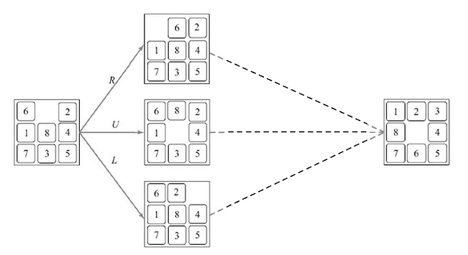
Figure 3: Which state is closest to the goal

Slide 15
h1(U) = (Again only 4, 5 and 7 are in their final place, but also the 5 blank tile.)
5
h1(L)= (2,4,5 and 7 are in place.)
5
Thus, according to h1, the best move is either U or L.
Let us look at another heuristic function h2 that adds up the Manhattan distance of each tile from its destination.
The values, counting from the blank tile, and then for tile-1 to tile-8, are:
h2(R)=(2+1+1+3+0+0+2+0+1)=10
h2(U)= (0 +1 +1 + 3 + 0 + 0 + 3+ 0 +2)=10
h2(L)=(2+1+0+3+0+0+3+0+1)=10

Slide 16
If one were to think of the heuristic values as obtained from solving a relaxed version of the Eight-puzzle then the first one can be thought of as a problem, where a tile can be moved to its destination in one move, and the second heuristic from a problem where a tile can move even over existing tiles.
The values are the total number of moves that need to be made in the relaxed problem(s).
Curiously, this more detailed function seems to think that all moves are equally good.
The Eight-puzzle has its bigger cousins, the 15-puzzle and the 24-puzzle, played on a 4 x 4 and a 5 x 5 grid respectively.
The state spaces for these puzzles are much larger.

Slide 17
The 15-puzzle has about 10000000000000 (or more succinctly 10¹³) states, while the 24-puzzle has about 10²⁵ states.
These are not numbers to trifle with. With an algorithm inspecting a billion states a second, we would still need more than a thousand centuries to exhaustively search the state space.
Only recently have machines been able to solve the 24-puzzle, and that requires a better heuristic function than the ones we have.

